Slide 1
Zk-snark voting
Department of radio engineering and cybernetics
Moscow institute of physics and technology
dolgoprudny
2019

Slide 2

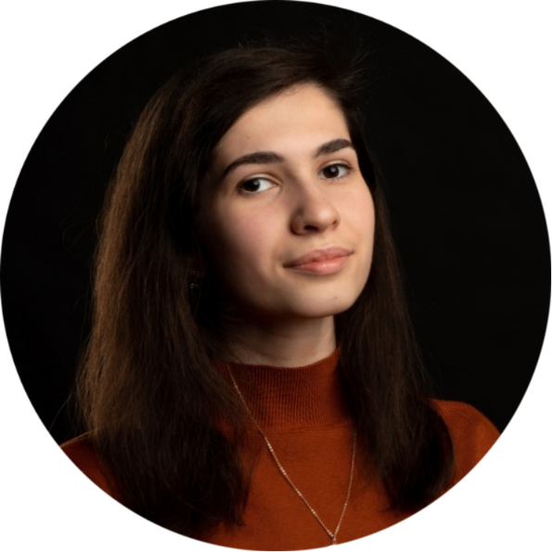

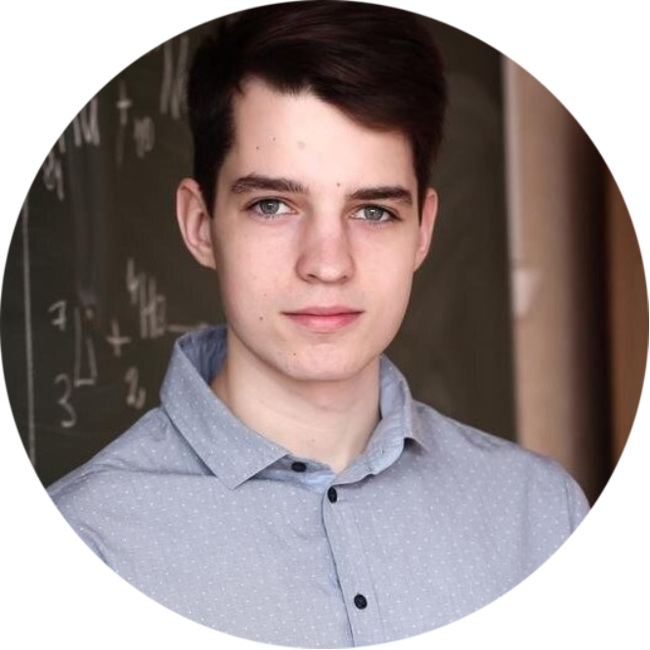
Our team
ANASTASIYA SMESHKO
gr. 613
smeshwith@gmail.com BACKEND
QAP TRUSTED SETUP
ROMAN DETININ
gr. 614
detinin.ra@phystech.edu
FRONTEND BACKEND ARCHITECTURE
KAMILA RAGIMOVA
gr. 611
ragimova.kb@phystech.edu BACKEND
ELLIPTIC
CRYPTOGRAPHY
POLINA STARODUMOVA
gr. 612
starodumova.pa@phystech.edu BACKEND
PROVER
VERIFIER

Slide 3
ZK-snarks
Zero-Knowledge Succinct Non-Interactive Argument of Knowledge
The goal of zero-knowledge proofs is for a verifier to be able to convince itself that a prover possesses knowledge of a secret parameter, called a witness, satisfying some relation, without revealing the witness to the verifier or anyone else
In general it is a program taking two inputs: C(x, w).
The input x is the public input, and w is the secret witness input
The output is boolean
The goal is to get a specific public input x to prove that the prover knows a secret input w that C(x, w) = true

Slide 4
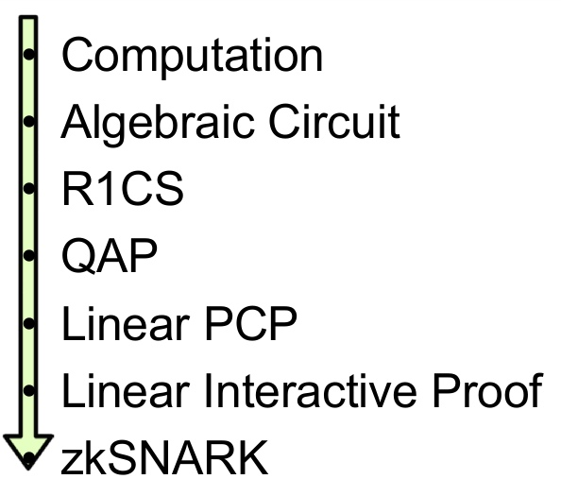
Quadratic Arithmetic Programs

Slide 5
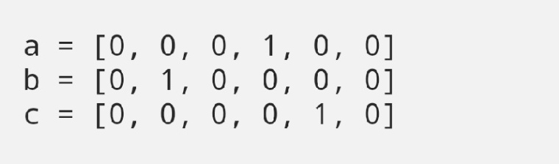
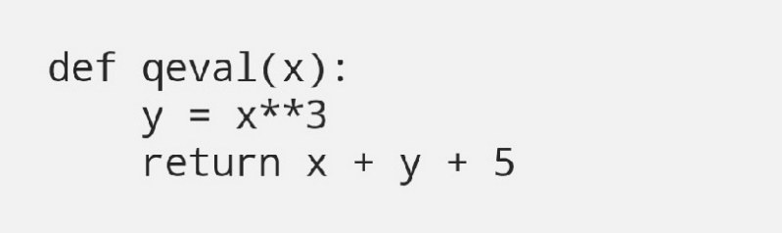
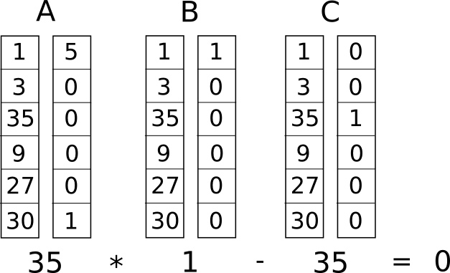
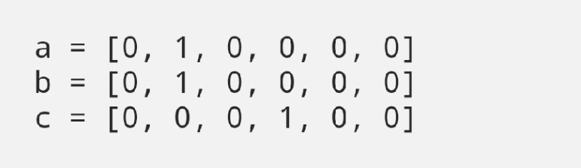
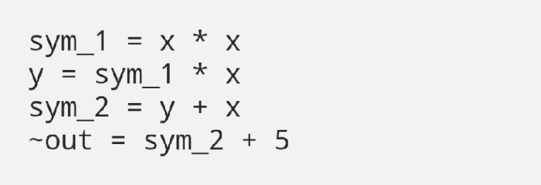
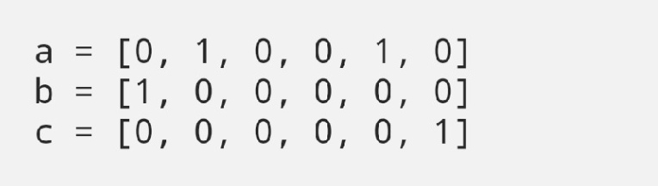
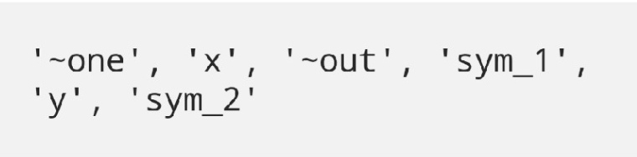
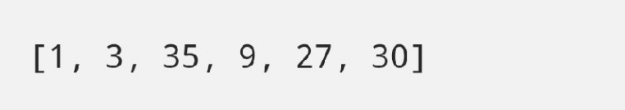
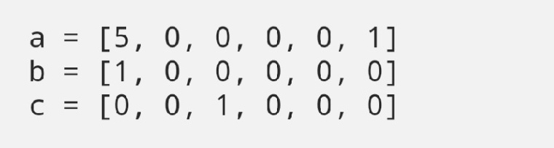
Quadratic Arithmetic Programs

Slide 6
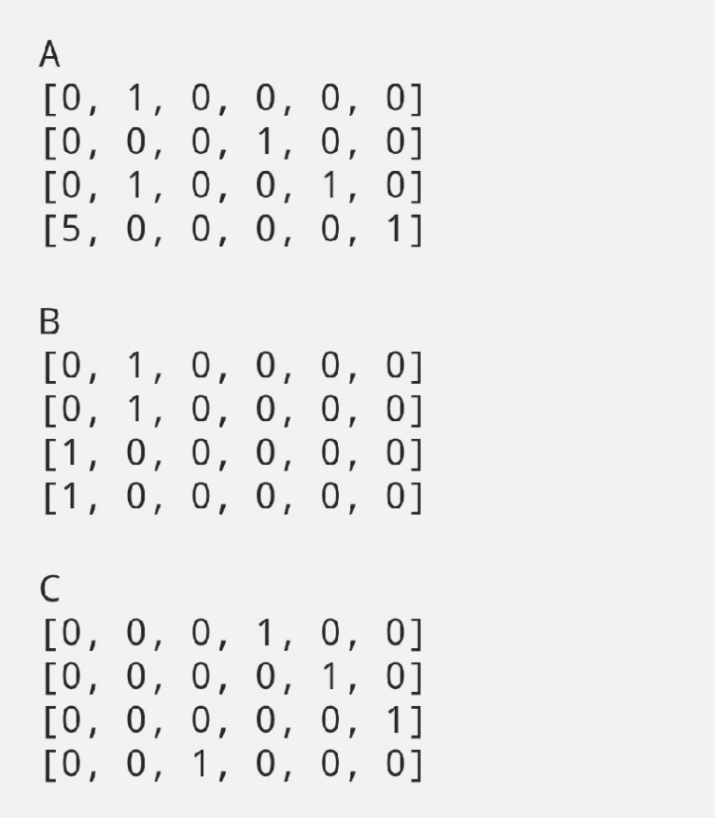
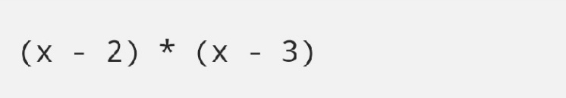
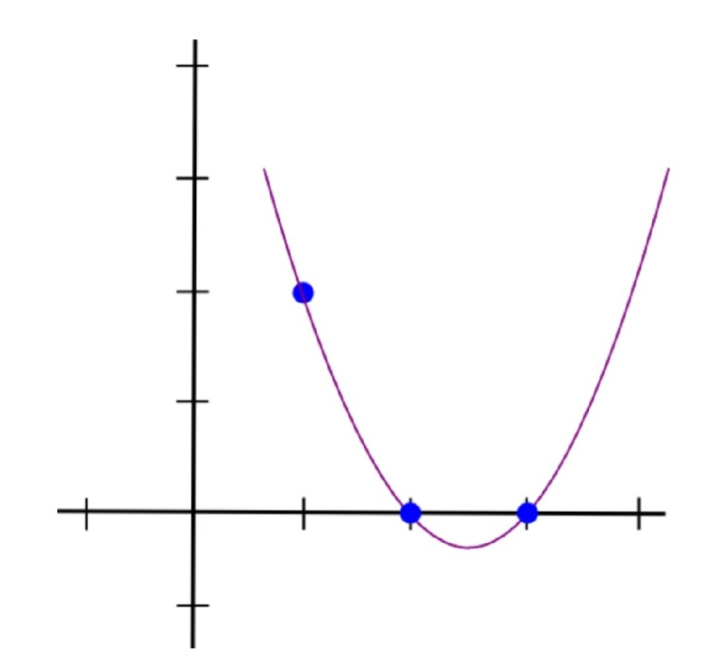
Quadratic Arithmetic Programs

Slide 7
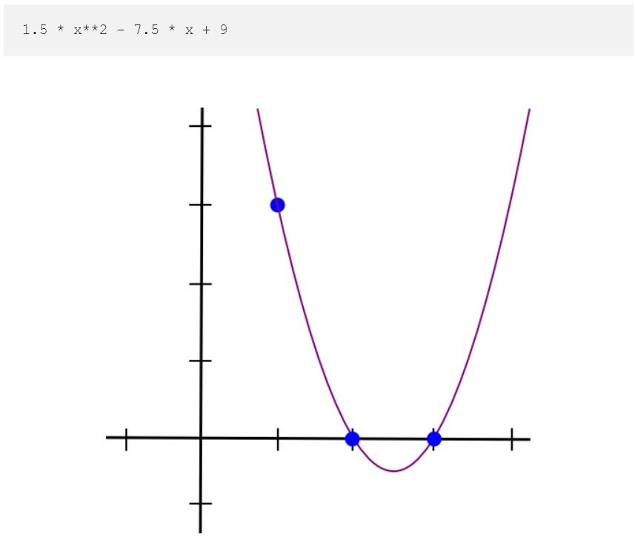
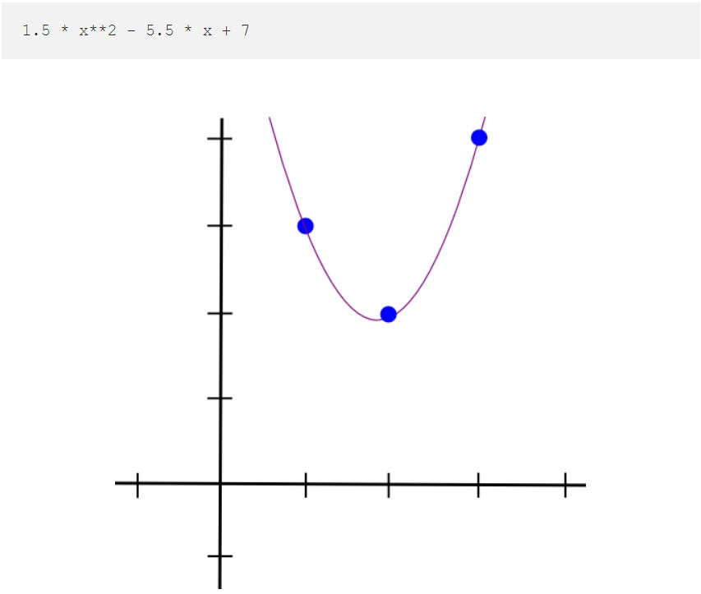
Quadratic Arithmetic Programs

Slide 8
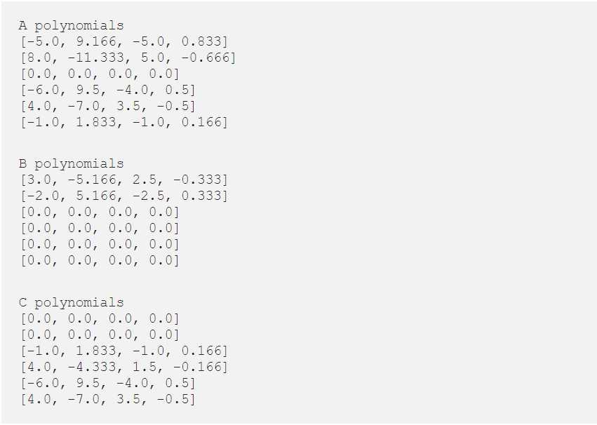
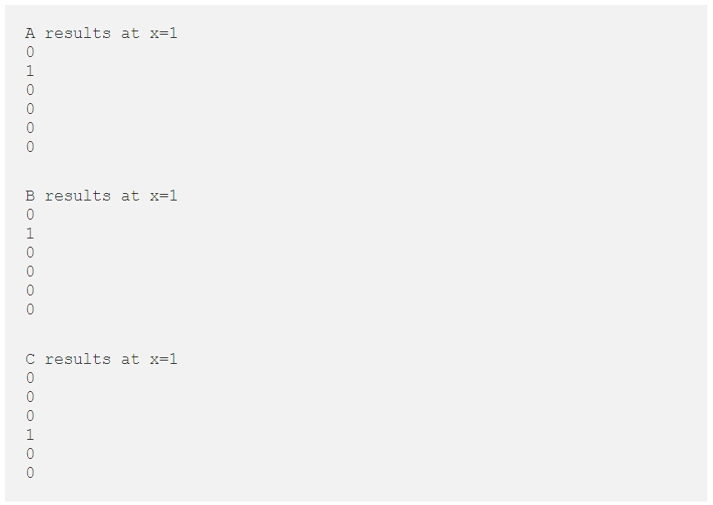
Quadratic Arithmetic Programs

Slide 9
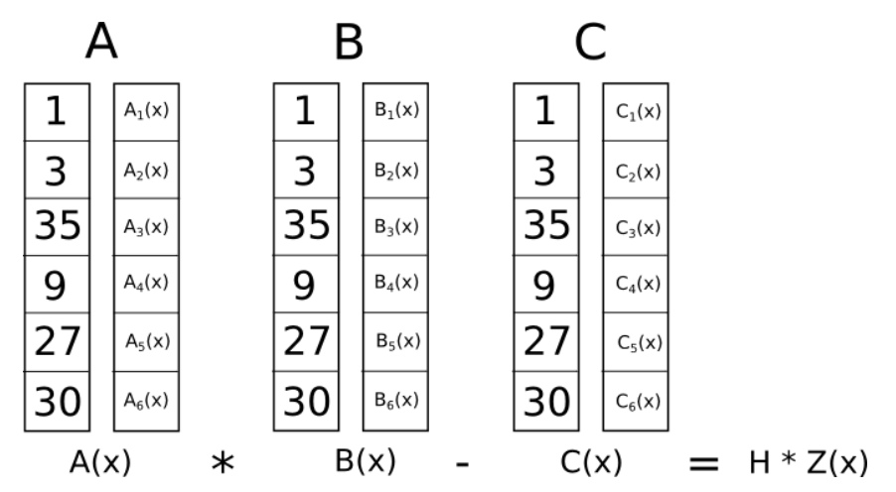
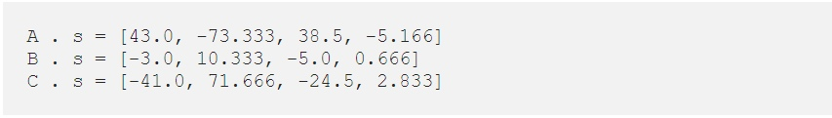
Quadratic Arithmetic Programs

Slide 10
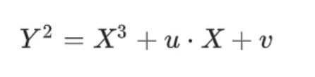
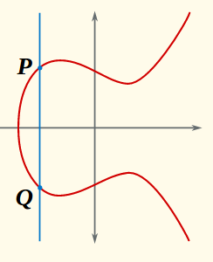
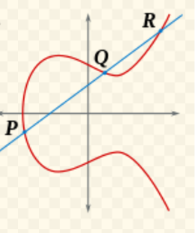
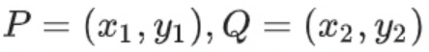
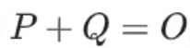
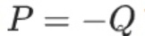
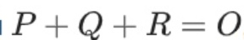
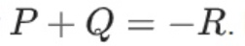
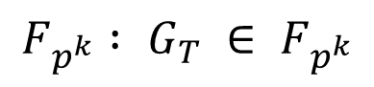
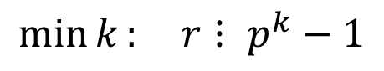
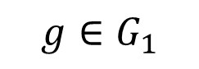
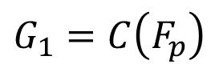
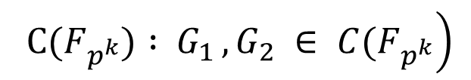
Elliptic curves and their pairings
$$G_{1}=C\left(F_{p}\right)$$
$$g∈G_{1}$$
$$\min{k}: r⋮ p^{k}−1$$
$$F_{p^{k}} : G_{T} ∈ F_{p^{k}}$$
$$\left. {С(F}_{p^{k}}) : { G}_{1 }, G_{2} ∈ {C(F}_{p^{k}}\right)$$

Slide 11
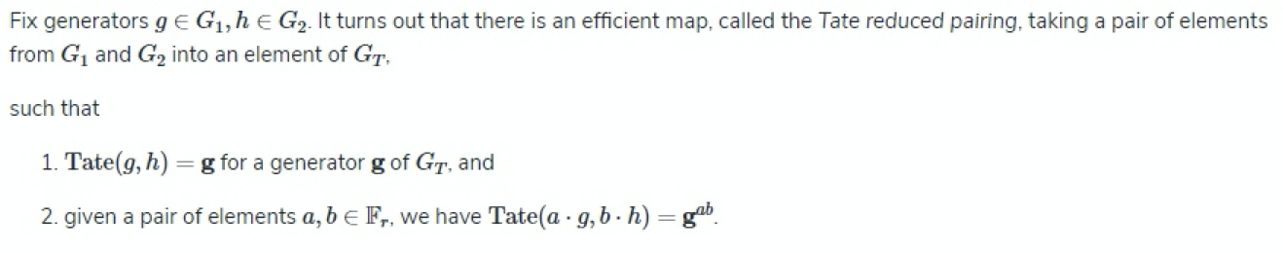
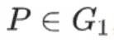
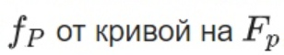
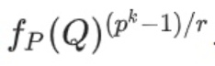
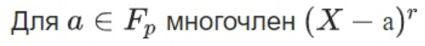
Elliptic curves and their pairings

Slide 12
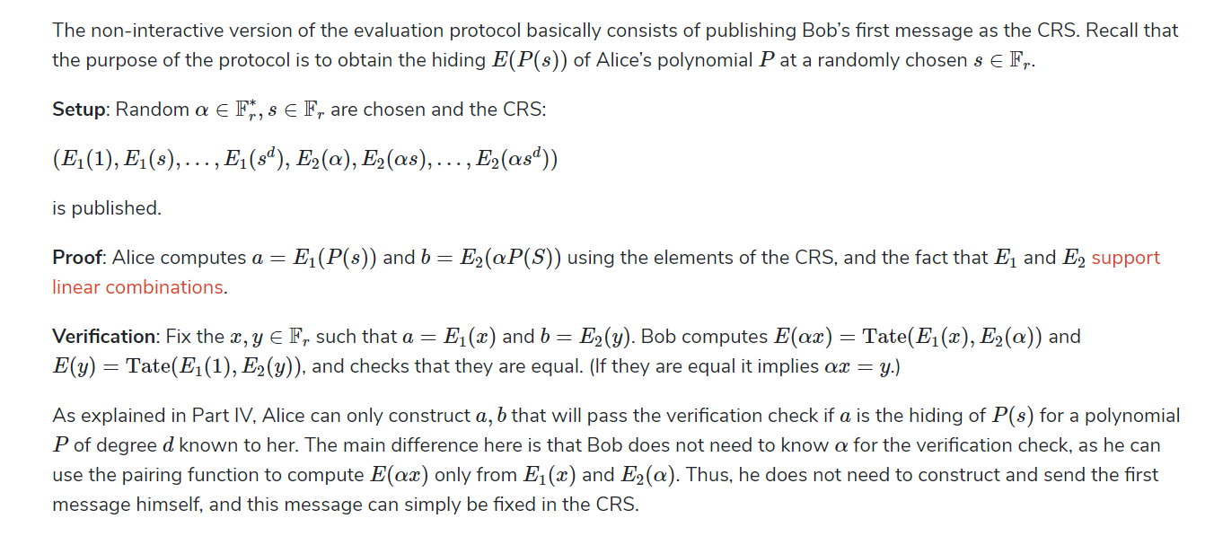
A non-interactive evaluation protocol

Slide 13
results
We present the realization for the electronic voting using zk-SNARKs principles
Trusted setup is done by the third party before voting.
Voter generates proof using his unique number and send to the verifier points on elliptic curve (which do not reveal any secret information about voter)
Verifier checks if these points correspond to real voters. If yes, the vote is counted by our base

Slide 14
Architecture
VALIDATION APP
FLASK APP
SERVER
SERVER
PROXY
CLIENT
SOCKET
REST API
CLIENT

Slide 15
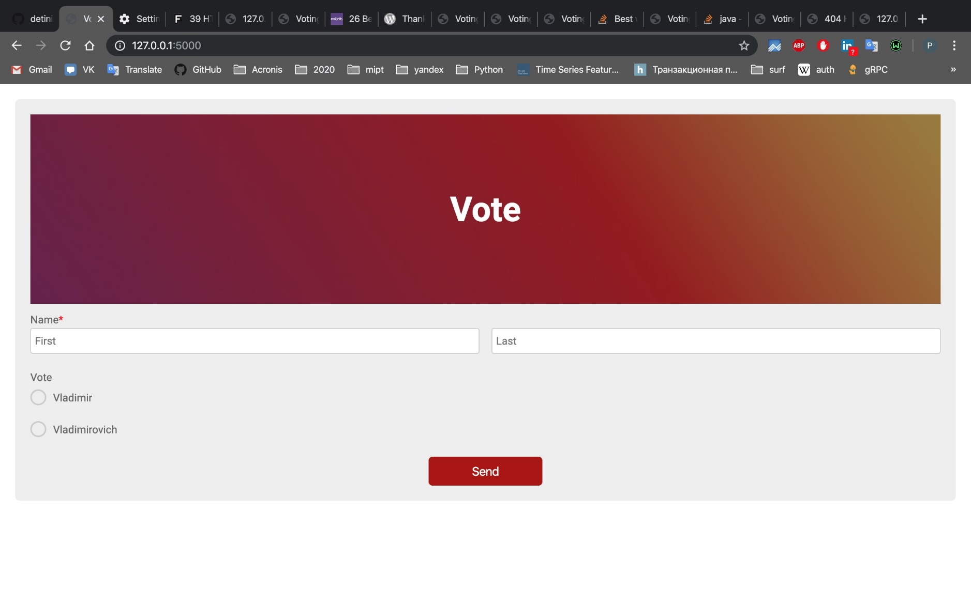
Our voting

Slide 16
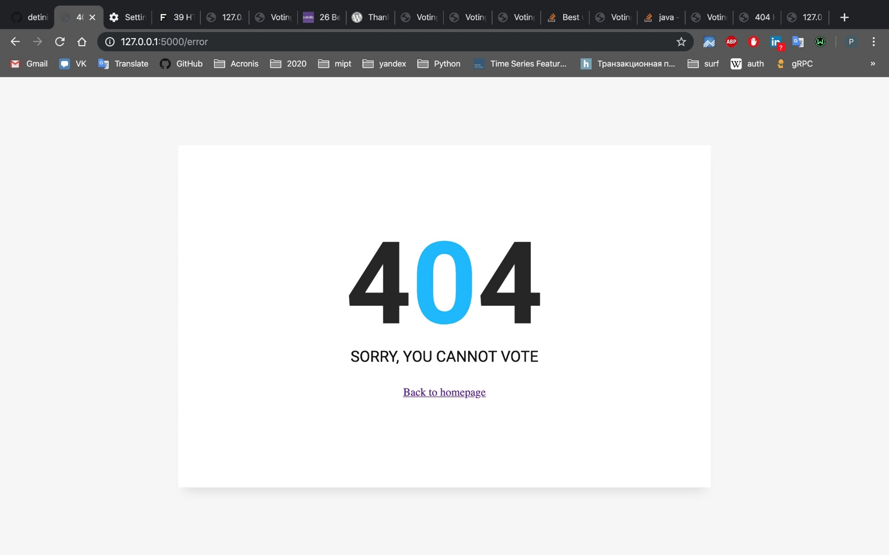
ERROR

Slide 17
SUCCESS

